Slide 1
On the Expressive Power of Deep Learning: A Tensor Analysis
Benyou wang
Cohen N, Sharir O, Shashua A. On the expressive power of deep learning: A tensor analysis[C]//Conference on Learning Theory. 2016: 698-728.

Slide 2
Deep Learning
Machine learning
AI
Supervised Learning
CNN
Deep Learning

Slide 3
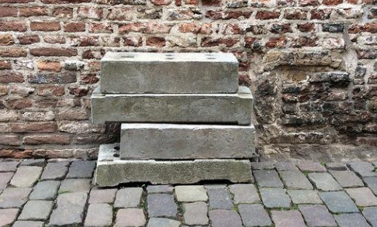
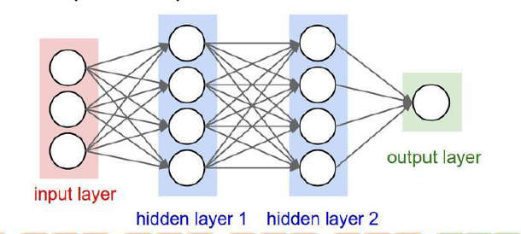
Deep and shadow Learning

Slide 4
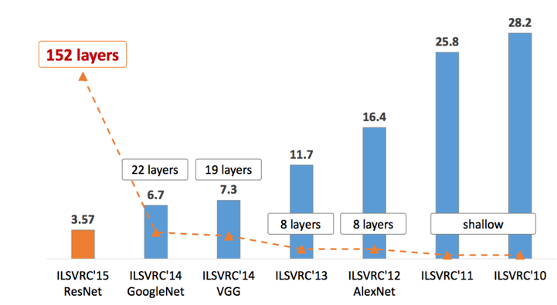
CNN, one typical NN of DL
Expressive power of depth – the driving force behind Deep Learning
Empirically, the deeper, the better?

Slide 5

Not only performance, but also interpretability
performance
interpretability
The ImageNet challenge ended in 2017. http://image-net.org/challenges/LSVRC/2017/

Slide 6
Questions
Why the deeper,
the better?

Slide 7
Expressive power of DL with a tensor analysis
Link CNN to Tensor Decomposition
Shadow CNN
Deep CNN
Theorem of Network Capacity

Slide 8
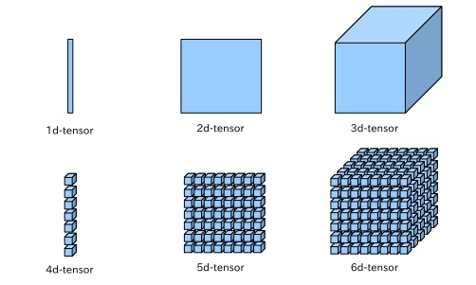
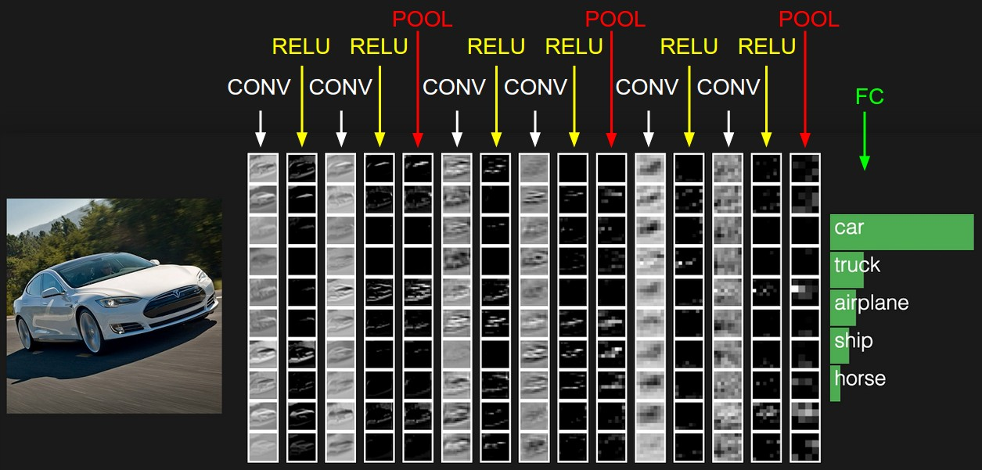
CNN and Tensor Decomposition

Slide 9






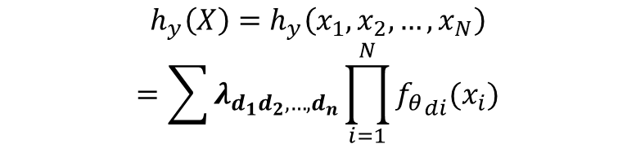





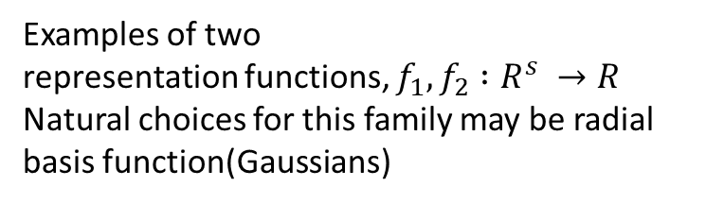
New hypotheses
$$λ_{0000}{f_{0}\left(x_{0}\right)f}_{0}{{\left(x_{1}\right)f}_{0}\left(x_{2}\right)f}_{0}(x_{3})$$
$$λ_{0001}{f_{0}\left(x_{1}\right)f}_{0}{{\left(x_{1}\right)f}_{0}\left(x_{2}\right)f}_{1}(x_{3})$$
$$λ_{0010}{f_{0}\left(x_{0}\right)f}_{0}{{\left(x_{1}\right)f}_{1}\left(x_{2}\right)f}_{0}(x_{3})$$
$$λ_{0011}{f_{0}\left(x_{0}\right)f}_{0}{{\left(x_{1}\right)f}_{1}\left(x_{2}\right)f}_{1}(x_{3})$$
$$λ_{0100}{f_{0}\left(x_{0}\right)f}_{1}{{\left(x_{1}\right)f}_{0}\left(x_{2}\right)f}_{0}(x_{3})$$
…
Examples of two
representation functions, $f_{1},f_{2} :R^{s} →R$
Natural choices for this family may be radial basis function(Gaussians)
$$λ_{1111}{f_{1}\left(x_{0}\right)f}_{1}{{\left(x_{1}\right)f}_{1}\left(x_{2}\right)f}_{1}(x_{3})$$
$$h_{y}\left(X\right)=h_{y}\left(x_{1},x_{2},…,x_{N}\right)$$
$$=\sum{λ_{d_{1}d_{2},…,d_{n}}\prod_{i=1}^{N}{{f_{θ}}_{di}(x_{i})}}$$

Slide 10

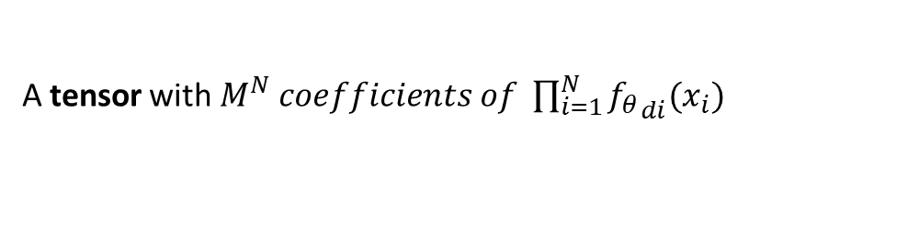
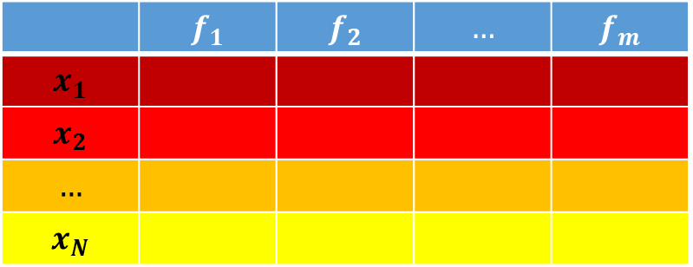
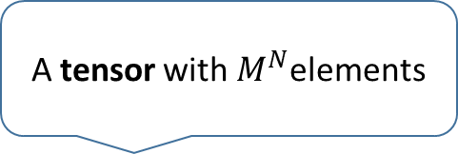
Representation layer
A tensor with $M^{N}$elements
$h_{y}\left(X\right)=h_{y}\left(x_{1},x_{2},…,x_{N}\right)=\sum{λ_{d_{1}d_{2},…,d_{n}}\prod_{i=1}^{N}{{f_{θ}}_{di}(x_{i})}}$
 | $$f_{1}$$ | $$f_{2}$$ | $$…$$ | $$f_{m}$$
$$x_{1}$$
$$x_{2}$$
$$…$$
$$x_{N}$$
A tensor with $M^{N} coefficients of \prod_{i=1}^{N}{{f_{θ}}_{di}(x_{i})}$

Slide 11
Tensor

Slide 12
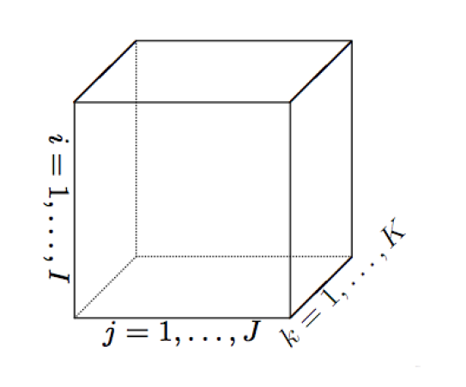
Tensor
Tensor is high-dimensional array $A∈R^{M_{1}×M_{2}×.. . M_{N}}$
With a index/location $\{d_{1},d_{2},…d_{N}\}$ $∈I$ we can get an element $λ_{d_{1}d_{2}…d_{n}}$ where $d_{1}∈\left[M_{1}\right], d_{N}∈[M_n]$
Fiber is high-dimensional analogue of column/row in matrix, for a 3-dimentional tensor, they are $A_{:,i_{2},i_{3} }$, $A_{i_{1},:,i_{3} }$ and $A_{i_{1},i_{2},:,}$
Slice is high-dimensional sections of a tensor, for a 3-dimentional tensor, they are $A_{i_{1},:,: }$, $A_{:,i_{2},:}$, and$A_{:,:,i_{3}}$

Slide 13
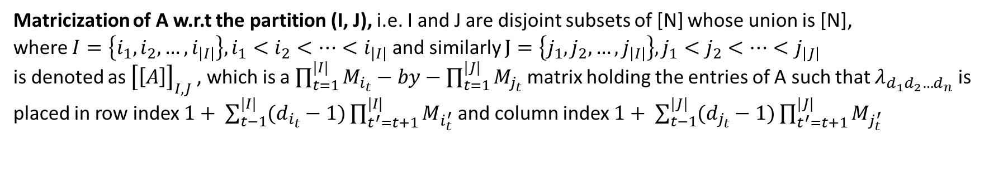
Tensor
Matricization of A w.r.t the partition (I, J), i.e. I and J are disjoint subsets of [N] whose union is [N],
where $I=\left\{i_{1},i_{2},…, i_{\left|I\right|}\right\}, i_{1}<i_{2}<…<i_{\left|I\right|}$ and similarly $J=\left\{j_{1},j_{2},…, j_{\left|I\right|}\right\}, j_{1}<j_{2}<…<j_{\left|J\right|}$
is denoted as ${\left[\left[A\right]\right]}_{I,J}$, which is a $\prod_{t=1}^{|I|}{M_{i_{t}}−by−\prod_{t=1}^{|J|}{M_{j_{t}}}}$ matrix holding the entries of A such that $λ_{d_{1}d_{2}…d_{n}}$ is placed in row index $1+ \sum_{t−1}^{|I|}{(d_{i_{t}}−1)\prod_{t^{′}=t+1}^{|I|}{M_{i_{t}^{′}}}}$ and column index $1+ \sum_{t−1}^{|J|}{(d_{j_{t}}−1)\prod_{t^{′}=t+1}^{|J|}{M_{j_{t}^{′}}}}$
Tensor product (also named Kronecker product for matrix), denoted by $⊗$, for example, $A∈R^{M_{1}× …M_{P}}$ and $B∈R^{M_{P+1}×…×M_{P+Q}}$, Order P and Q resp.
The tensor product between A and B is $A⊗B∈R^{M_{1}× …M_{P+Q}}$,

Slide 14
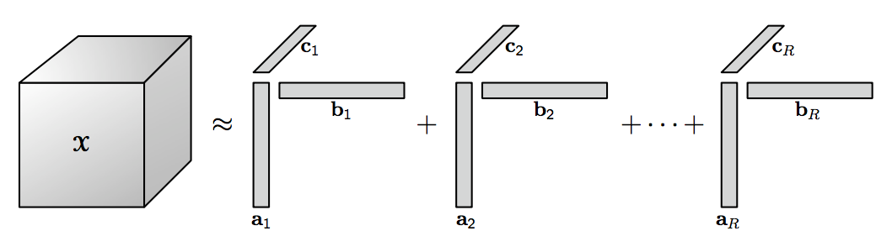
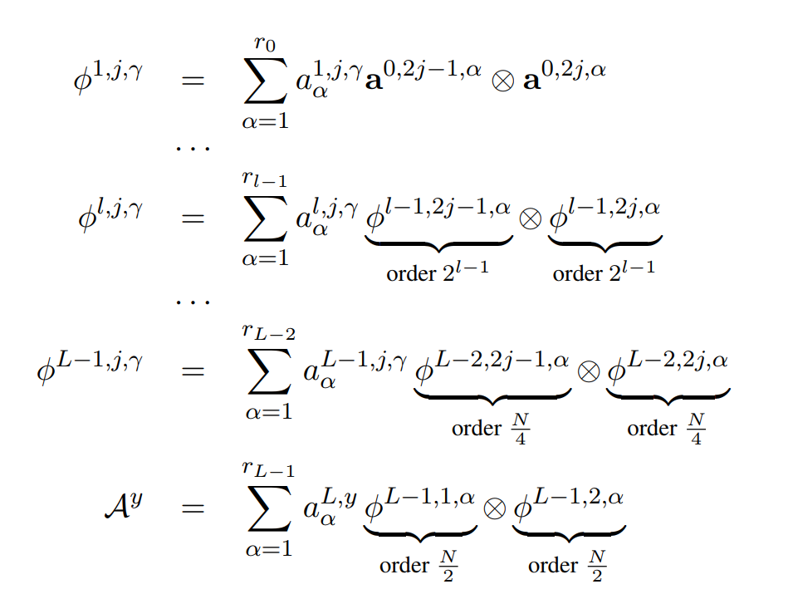
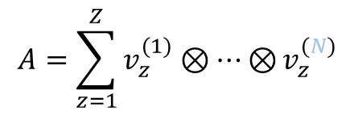
Tensor Decomposition
CP Decomposition
Tucker Decomposition
order
$$A=\sum_{z=1}^{Z}{v_{z}^{(1)}⊗…⊗}v_{z}^{(N)}$$
Hierarchical Tucker Decomposition
The rank-one tensor is pure or elementary
Any tensor can be expressed as a sum of rank-1 tensors

Slide 15
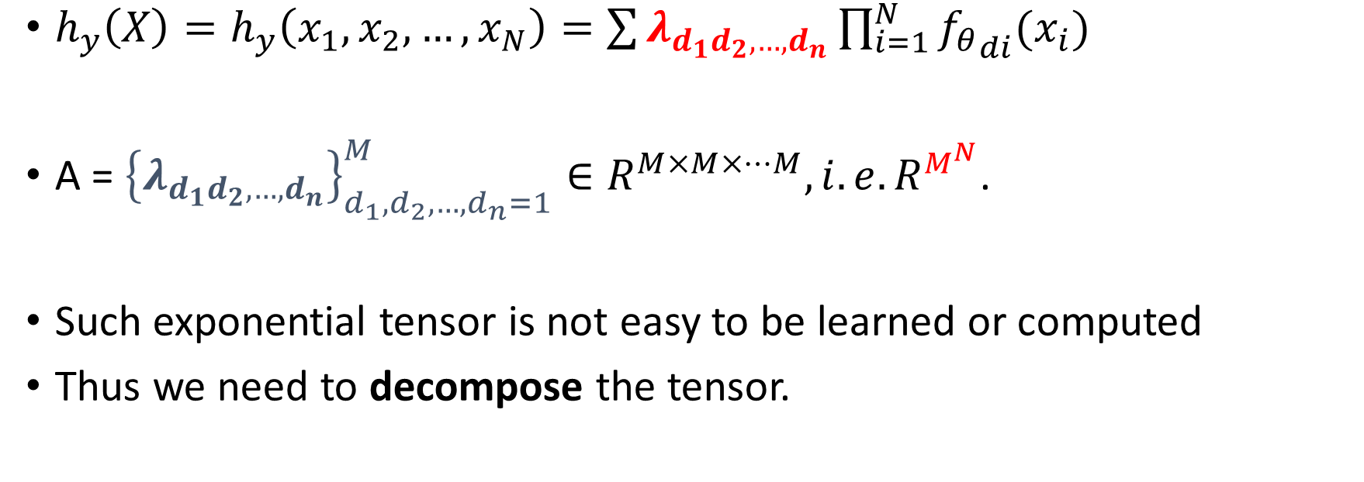
The Tensor in the hypotheses
$h_{y}\left(X\right)=h_{y}\left(x_{1},x_{2},…,x_{N}\right)=\sum{λ_{d_{1}d_{2},…,d_{n}}\prod_{i=1}^{N}{{f_{θ}}_{di}(x_{i})}}$
A = ${\left\{λ_{d_{1}d_{2},…,d_{n}}\right\}}_{d_{1},d_{2},…,d_{n}=1}^{M}∈R^{M×M×…M}, i.e.R^{M^{N}}$.
Such exponential tensor is not easy to be learned or computed
Thus we need to decompose the tensor.

Slide 16
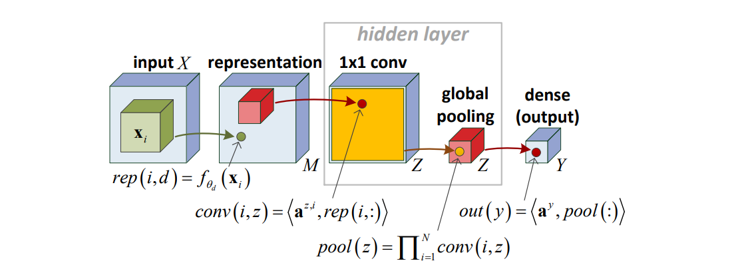
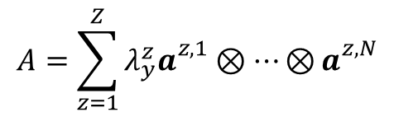
Shallow CNN vs. CP Decomposition
With CP decomposition
$$A=\sum_{z=1}^{Z}{{λ_{y}^{z}a}_{}^{z,1}⊗…⊗}a_{}^{z,N}$$
$h_{y}\left(X\right)=\sum{λ_{d_{1}d_{2},…,d_{n}}\prod_{i=1}^{N}{{f_{θ}}_{di}(x_{i})}}=\sum_{z=1}^{Z}{λ_{y}^{z}\prod_{i=1}^{N}{(\sum_{d=1}^{M}{a_{d}^{z,i}}f_{θ_{d}}(x_{i}))}}$
Convolution
Pooling (product pooling)
Multiple channels

Slide 17
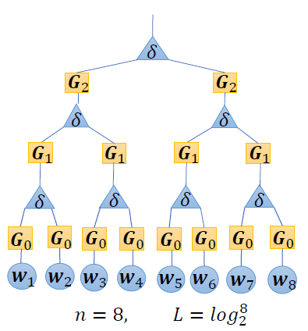
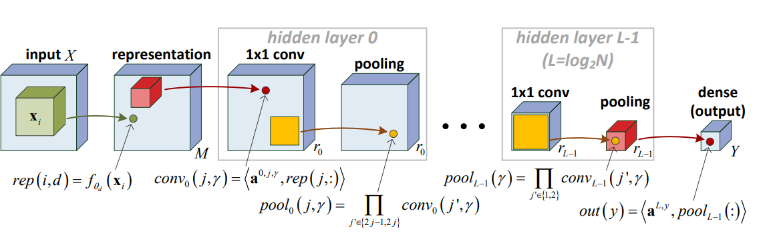
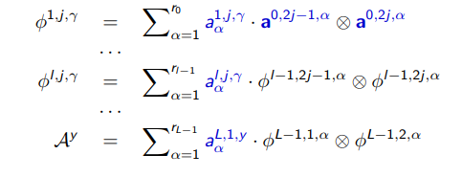
Deep CNN vs. HT Decomposition
L = log2 N hidden layers, non-overlap convolution, size-2 pooling windows

Slide 18
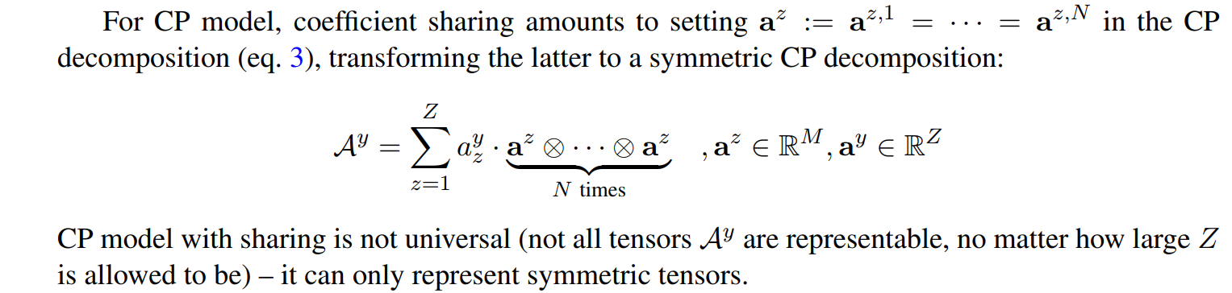
In the case of Shared weights

Slide 19
Core Theory
Besides a negligible (zero measure) set, all functions that can be realized by a deep network of polynomial size, require exponential size in order to be realized, or even approximated, by a shallow network

Slide 20
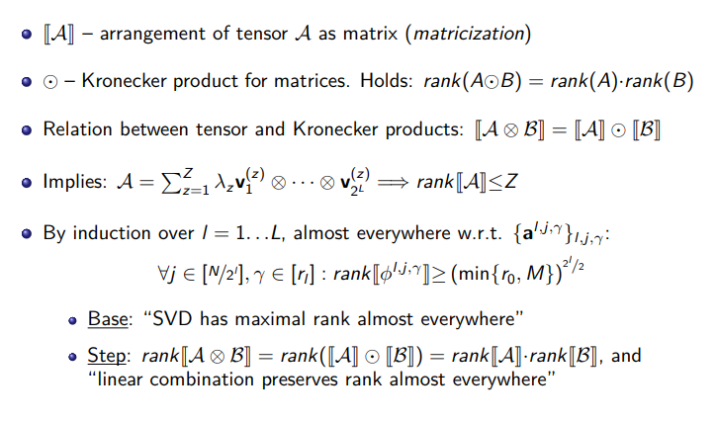
Proof Sketch

Slide 21
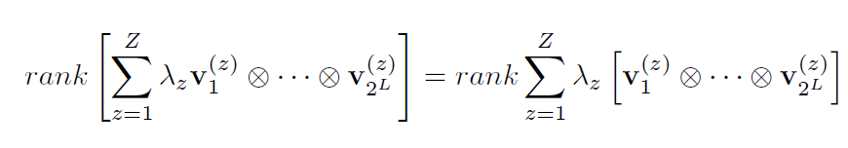
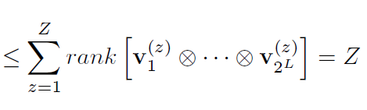

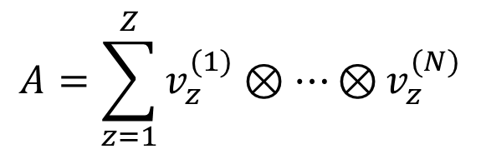
Shadow CNN & CP compostion
$$A=\sum_{z=1}^{Z}{v_{z}^{(1)}⊗…⊗}v_{z}^{(N)}$$
${{Rank [v}_{z}^{(1)}⊗…⊗v}_{z}^{(N)}$] = 1
Matricization is a linear operation

Slide 22
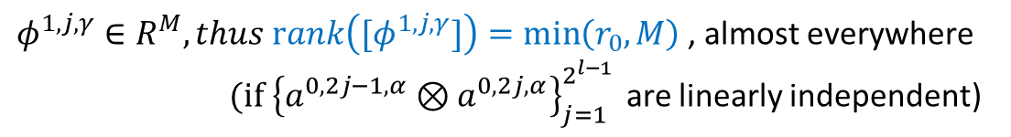

Deep CNN &
$φ^{1,j,γ}∈R^{M}, thus rank\left({[φ}^{1,j,γ}]\right)=\min\left(r_{0},M\right)$, almost everywhere
$(if {\left\{a^{0,2j−1,α}⊗a^{0,2j,α}\right\}}_{j=1}^{2^{l−1 }}$ are linearly independent)
Rank ($φ^{0,2j−1,α}⊗φ^{0,2j,α}$) >= ${\min\left(r_{0},M\right) }^{2}$, almost everywhere
Rank ($A^{y}$) >= ${\min\left(r_{0},M\right) }^{N/2}$, almost everywhere

Slide 23
Publications
Sentiment-Specific Embedding in Complex-valued Space, in process.
Qiuchi Li*, Benyou Wang*, Massimo Melucci. A Complex-valued Network for Matching. NAACL 2019
Benyou Wang*, Qiuchi Li*, Massimo Melucci, Dawei Song. Semantic Hilbert Space for Text Representation Learning. WWW 2019
Wei Zhao*, Benyou Wang*, Min Yang, Jianbo Ye, Zhou Zhao, Xiaojun Chen, Ying Shen.. Leveraging Long and Short-term Information in Content-aware Movie Recommendation via Adversarial Training. IEEE Transactions on Cybernetics (TOC), 2019

